Slide 1
Industry 4.0 Topic: Core Technologies: Cloud Computing and Fog Computing
Prepared by: Prof. Arindam Basak

Slide 2
What is computing?
Computing is the process of using computer technology to complete a given goal-oriented task.
Computing may encompass the design and development of software and hardware systems for a broad range of purposes - often structuring, processing and managing any kind of information to aid in the pursuit of scientific studies, making intelligent systems, and creating and using different media for entertainment and communication.
the use of a computer to process data or perform calculations.
It has scientific, engineering, mathematical, technological and social aspects.
The list is virtually endless, and the possibilities are vast………………..

Slide 3
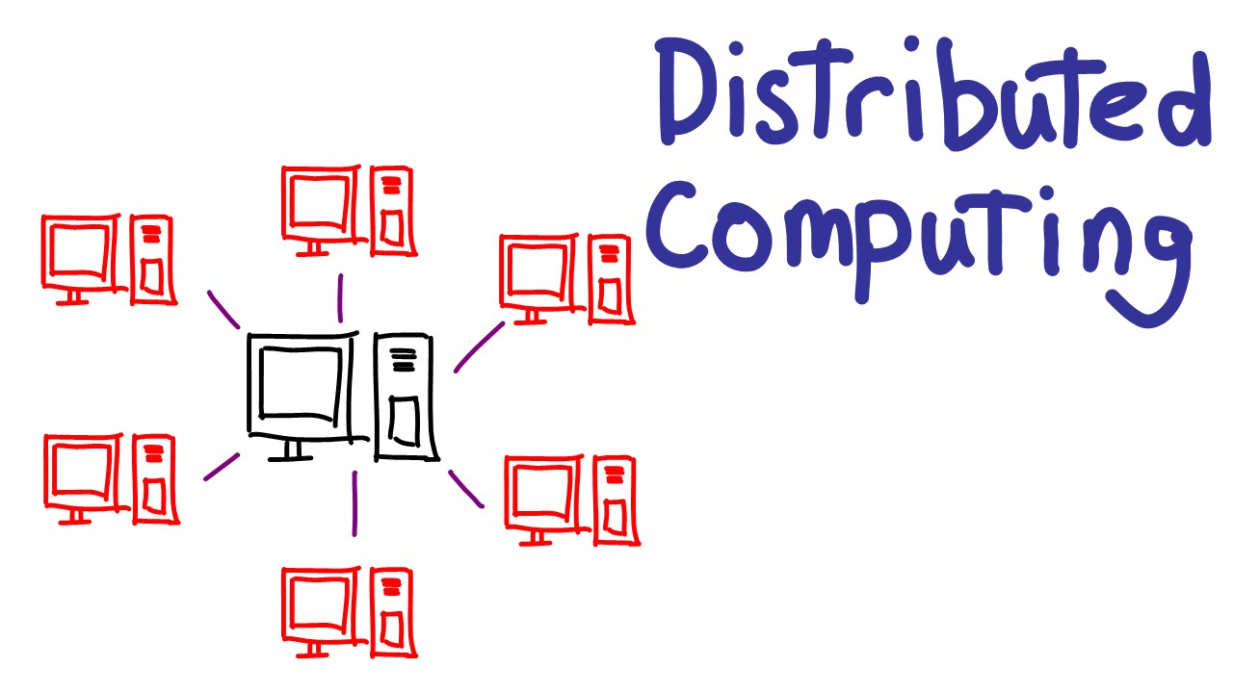

Slide 4
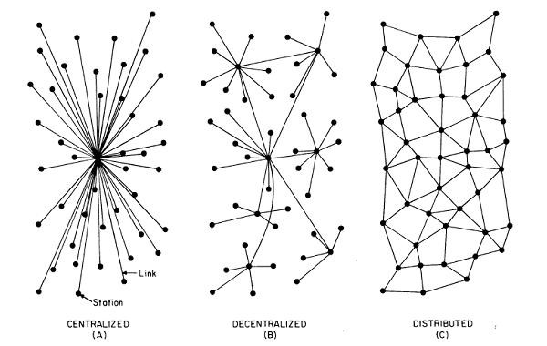

Slide 5
Distributed System Characteristics (SEAM)
To present a Single-system image:
Hide internal organization, communication details
Provide uniform interface
Easily Expandable
Adding new computers is hidden from users
Continuous Availability
Failures in one component can be covered by other components
Supported by Middleware

Slide 6
Advantages of Distributed System over Centralized System(SIRI)
Speed - When used to implement parallel processing where only goal is to achieve maximum speed on a single problem, distributed systems can achieve very high speed as compared to the centralized ones.
Inherent Distribution- Another reason for building a distributed system is that some applications are inherently distributed. Banking, Airline reservation etc. are examples of the applications that are inherently distributed . When all the branches of a bank are connected, we have a commercial distributed system.

Slide 7
Contd .
Reliability- By distributing the workload over many machines, a single chip failure will bring down at most one machine, leaving the rest intact.
For critical applications, such as control of nuclear reactors or aircraft, using a distributed system to achieve high reliability may be a dominant consideration
Incremental Growth- Often a company will buy a mainframe with the intention of doing all its work on it.
If the company prospers and the workload grows, at a certain point the mainframe will no longer be adequate.

Slide 8
Disadvantages of Distributed System
Software: difficult to develop software for distributed systems
Control :Distribution of control
Network: saturation, lossy transmissions
Security: easy access also applies to secret data
Hard to detect faults
Administration issues

Slide 9
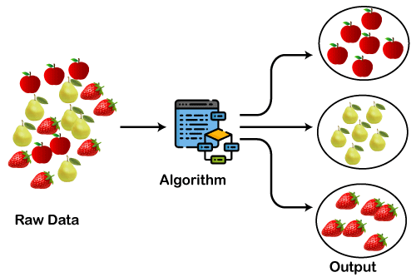
What is Cluster Computing?
A computer cluster is a group of linked computers, working together closely so that in many respects they form a single computer.
The components of a cluster are commonly, but not always, connected to each other through fast local area networks.
Clusters are usually deployed to improve performance and/or availability over that provided by a single computer, while typically being much more cost-effective than single computers of comparable speed.
APP
APP
…
APP
Cluster Middle ware
High Speed Local Network
CPU
CPU
…
CPU
Cluster

Slide 10
Cluster Computing
Advantages
Increasing speed – better performance
optimized resources utilization
Can execute Large applications
Disadvantages
Complex programming models
Difficult for debug and development

Slide 11
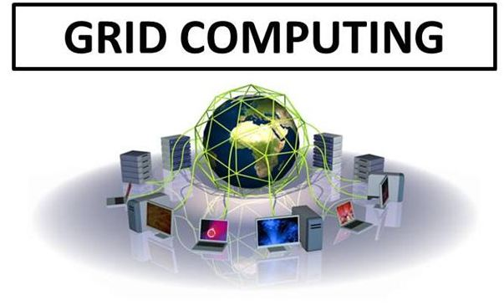

Slide 12
Grid Computing
Computing grids are conceptually and logically like electrical grids. In an electrical grid, wall outlet allow us to connect to an infrastructure of resources which generate and distribute the electricity. Likewise, in the IT industry, grid computing uses middleware to coordinate distinct IT resources over the network, allowing them to function and work as a virtual whole.
The goal of a computing grid , like that of a electrical grid, is to provide users with access to the resources they need, when they need them and to provide remote access to IT assets and aggregating processing power.
Grid provides a series of distributed computing resources via LAN or WAN to the terminal user’s application, as if he is using a super virtual computer.

Slide 13
Grid computing is the integration of computer resources for achieving similar objective.
Grids are frequently created with middleware software libraries of a common grid.
Grids are a type of dispersed computing system, whereas a virtualized super computer is made from various networked.
Grids focus on two different but associated objectives—supplying isolated access to IT resources and building up processing control.
The grid is a technology which controls two factors—allocation and trust.

Slide 14
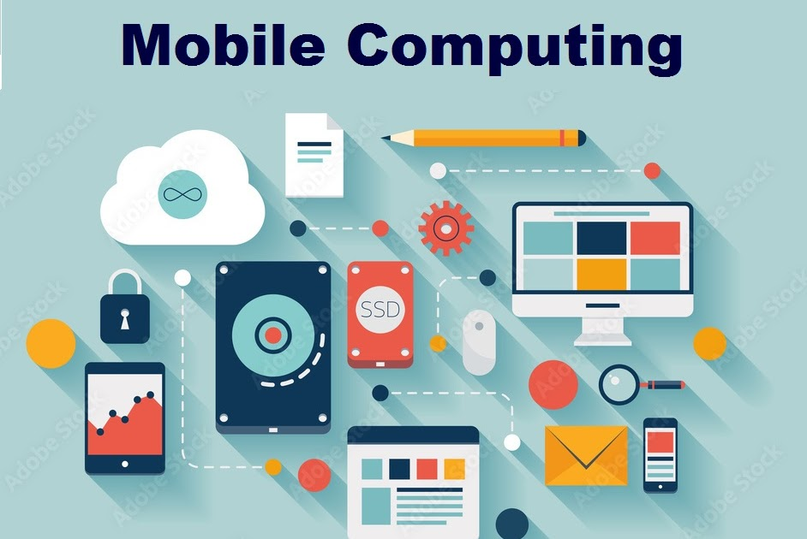

Slide 15
Mobile Computing
Mobile Computing is a technology that allows transmission of data, voice and video via a computer or any other wireless enabled device without having to be connected to a fixed physical link. The main concept involves −
Mobile communication
Mobile hardware
Mobile software

Slide 16
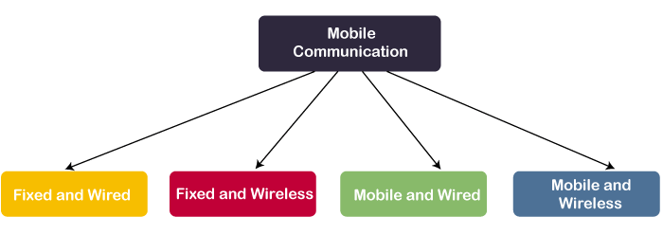
The mobile communication in this case, refers to the infrastructure put in place to ensure that seamless and reliable communication goes on. These would include devices such as protocols, services, bandwidth, and portals necessary to facilitate and support the stated services. The data format is also defined at this stage.

Slide 17
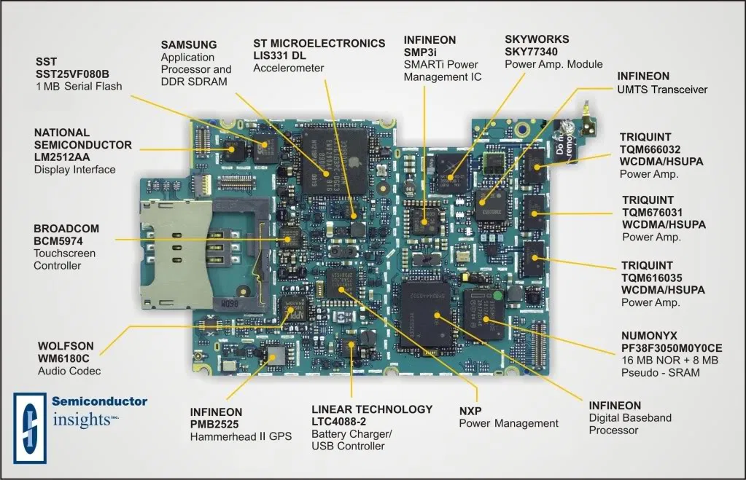
Mobile Hardware
Mobile hardware includes mobile devices or device components that receive or access the service of mobility. They would range from portable laptops, smartphones, tablet Pc's, Personal Digital Assistants.

Slide 18
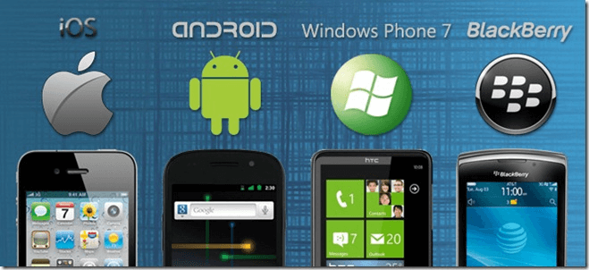
Mobile software
Mobile software is the actual program that runs on the mobile hardware. It deals with the characteristics and requirements of mobile applications. This is the engine of the mobile device. In other terms, it is the operating system of the appliance. It's the essential component that operates the mobile device.

Slide 19
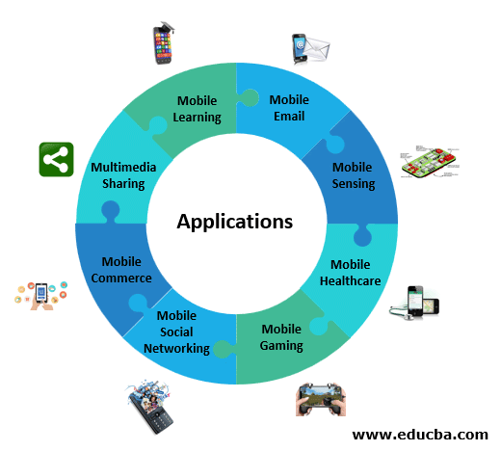

Slide 20
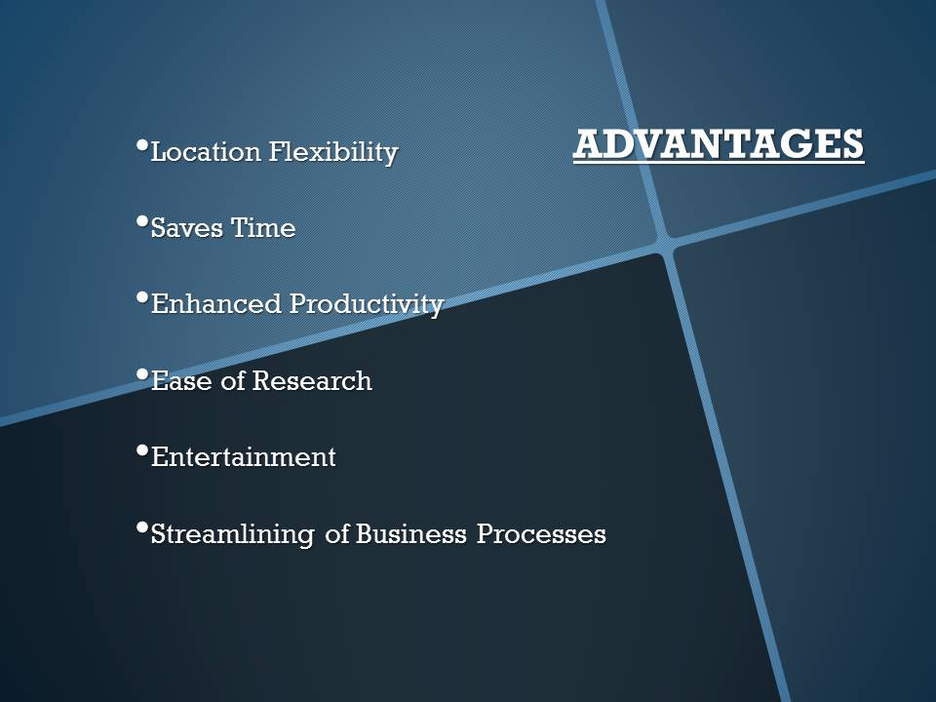

Slide 21
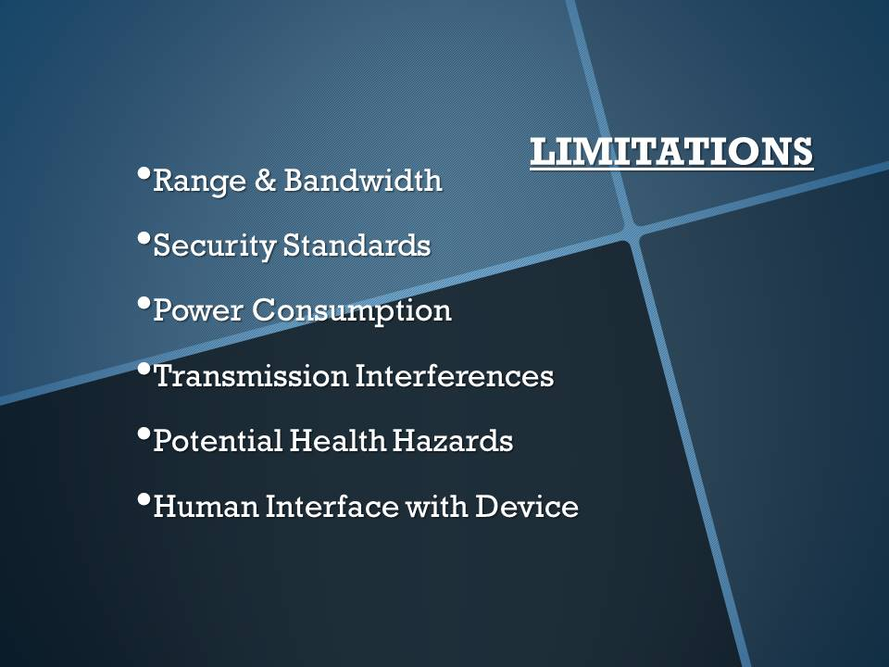

Slide 22
What is Cloud Computing?
Cloud Computing is a general term used to describe a new class of network based computing that takes place over the Internet,
basically a step on from Utility Computing
a collection/group of integrated and networked hardware, software and Internet infrastructure (called a platform).
Using the Internet for communication and transport provides hardware, software and networking services to clients

Slide 23
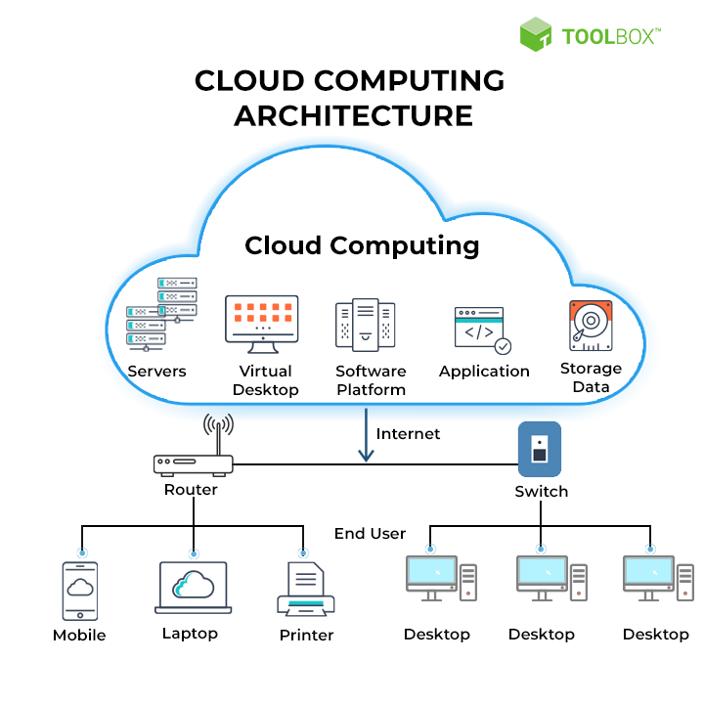

Slide 24
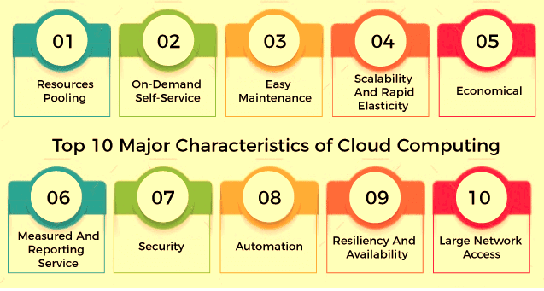

Slide 25
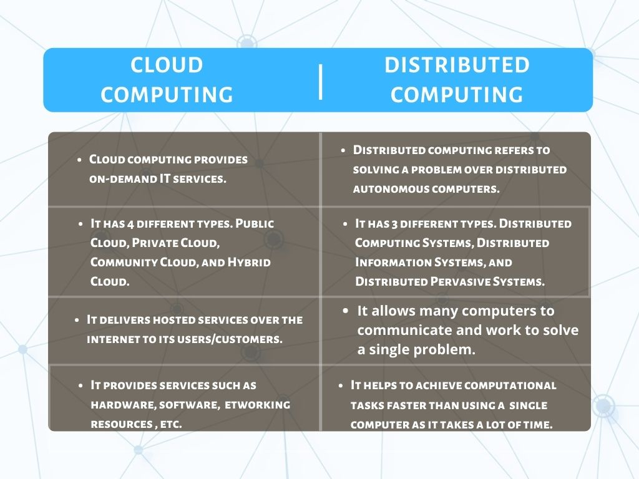

Slide 26
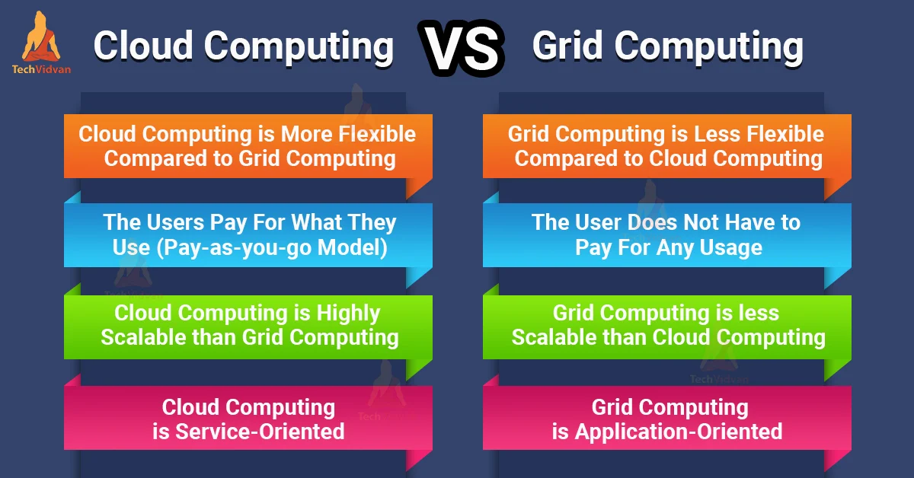

Slide 27
Basic Concepts
There are certain services and models working behind the scene making the cloud computing feasible and accessible to end users. Following are the working models for cloud computing:
Deployment Models
Service Models

Slide 28
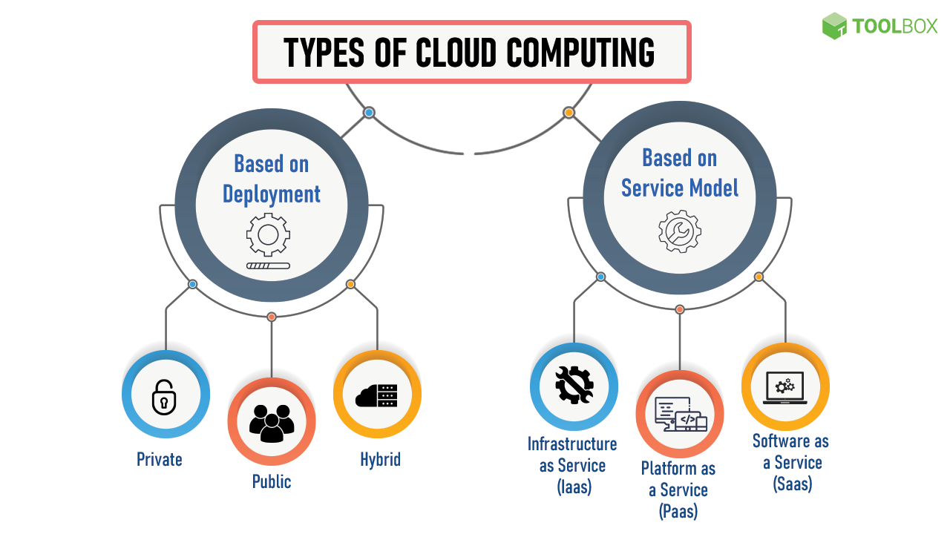

Slide 29
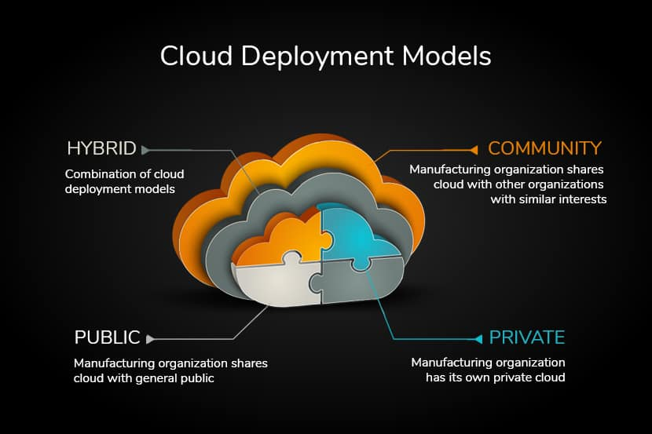

Slide 30
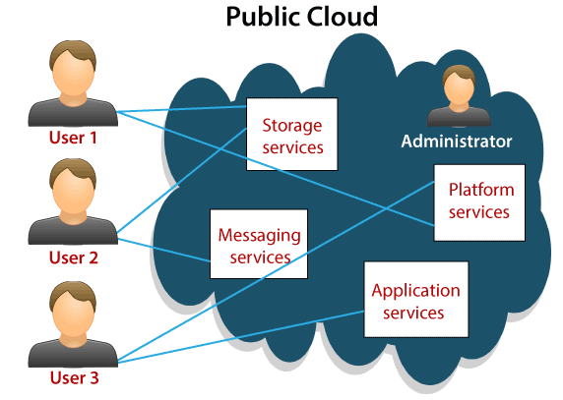
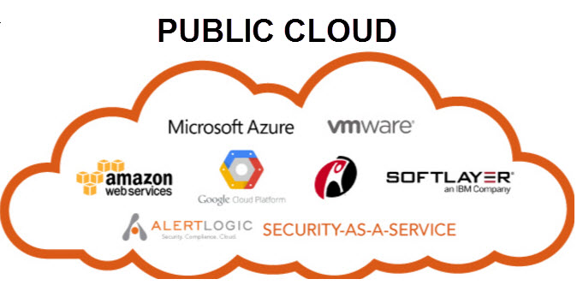
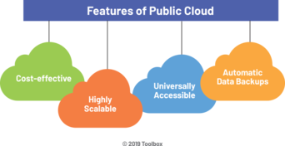

Slide 31
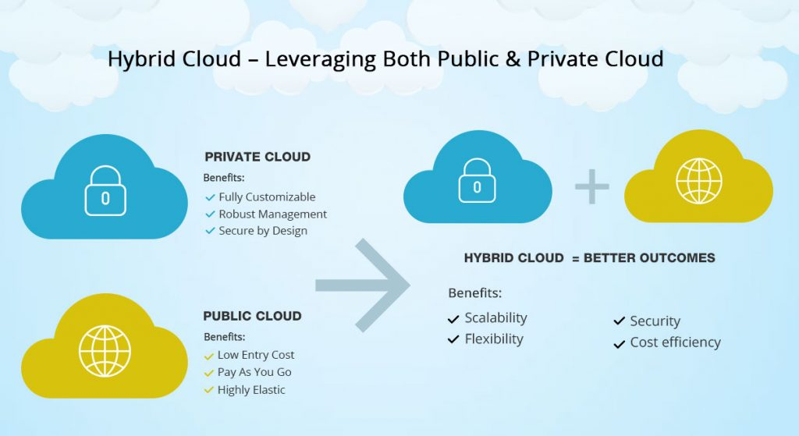

Slide 32
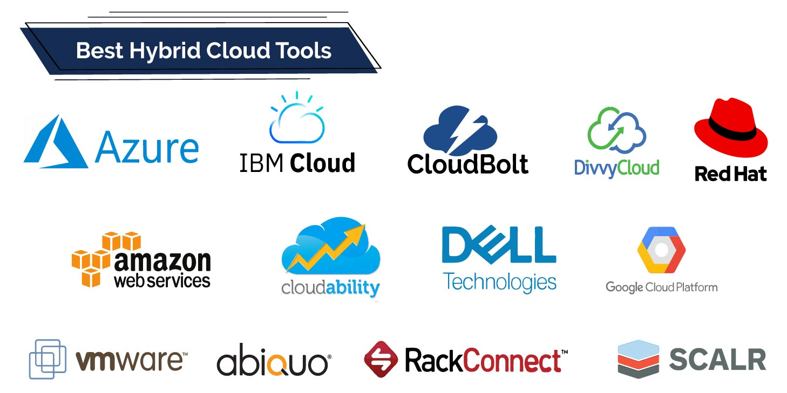
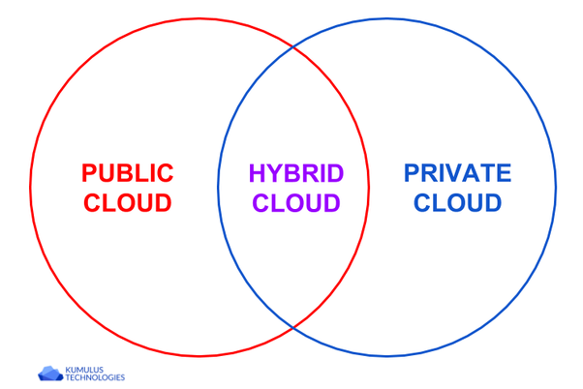
Hybrid Cloud
Top 5 Hybrid Cloud Providers:
Amazon
Microsoft
Google
Cisco
NetApp

Slide 33
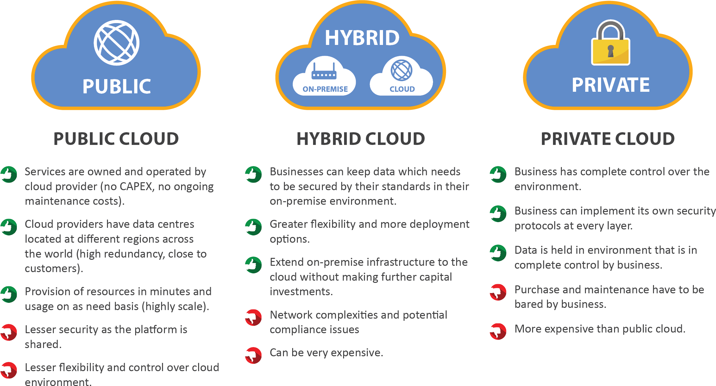

Slide 34
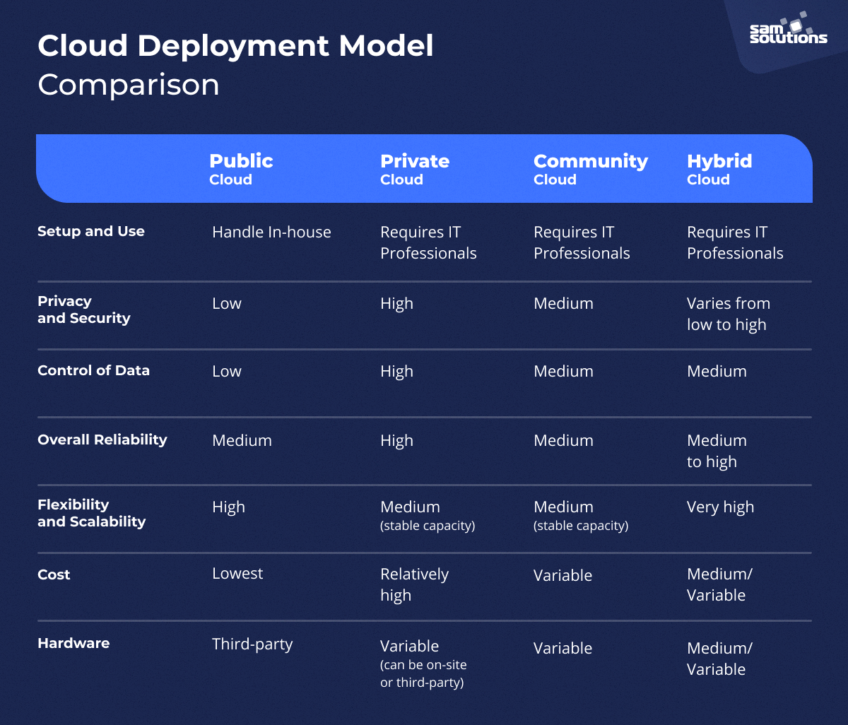

Slide 35
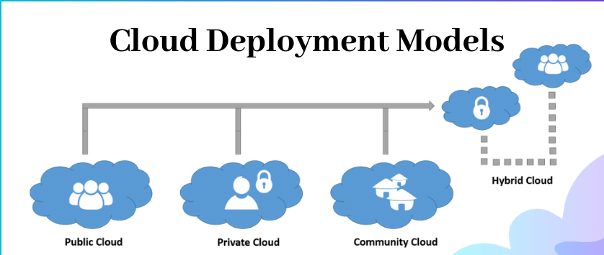
Deployment Models
The Public Cloud allows systems and services to be easily accessible to the general public. Public cloud may be less secure because of its openness, e.g., e-mail.
The Private Cloud allows systems and services to be accessible within an organization. It offers increased security because of its private nature.
Cummunity Cloud -The Community Cloud allows systems and services to be accessible by group of organizations.
The Hybrid Cloud -is mixture of public and private cloud. However, the critical activities are performed using private cloud while the non-critical activities are performed using public cloud.

Slide 36
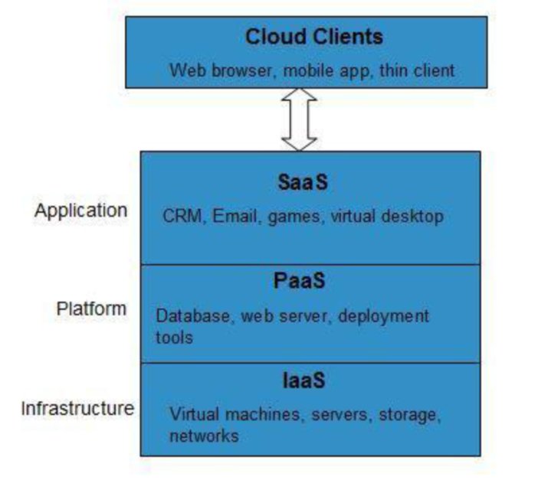
Service Models
INFRASTRUCTURE AS A SERVICE (IAAS)
IaaS provides access to fundamental resources such as physical machines, virtual machines, virtual storage, etc.
PLATFORM AS A SERVICE (PAAS)
PaaS provides the runtime environment for applications, development & deployment tools, etc.
SOFTWARE AS A SERVICE (SAAS)
SaaS model allows to use software applications as a service to end users

Slide 37
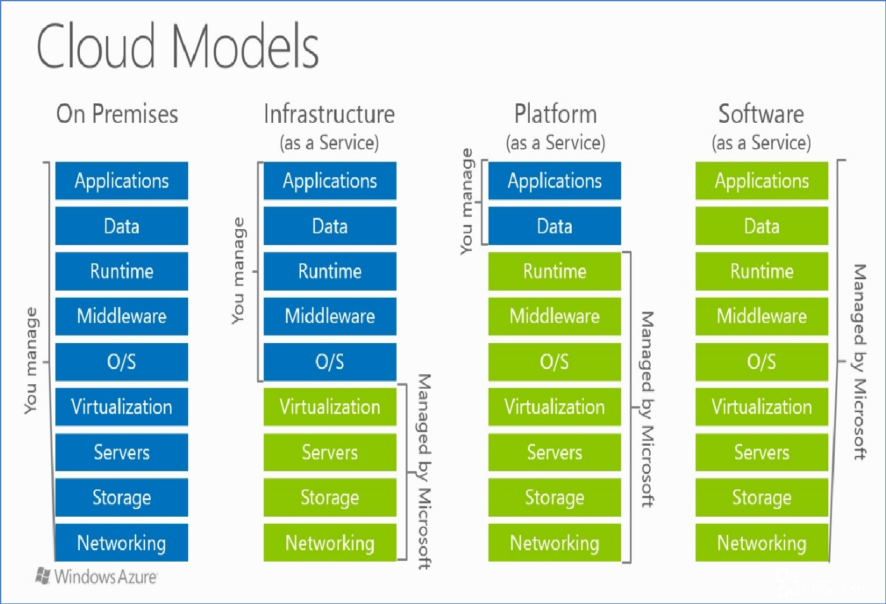

Slide 38
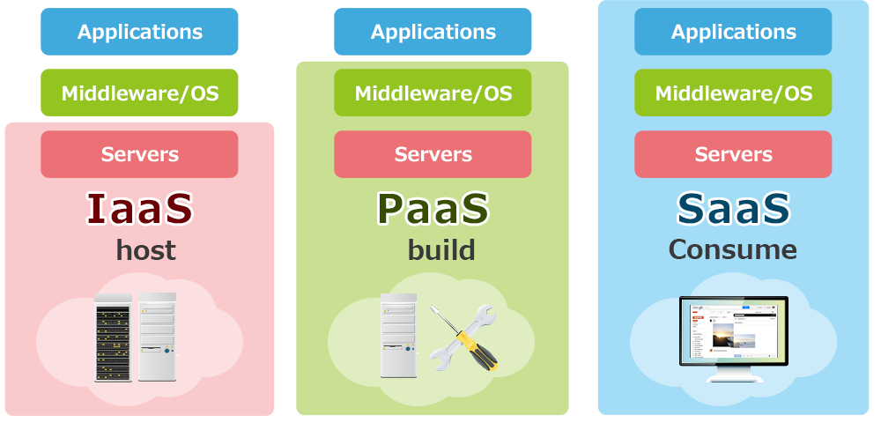
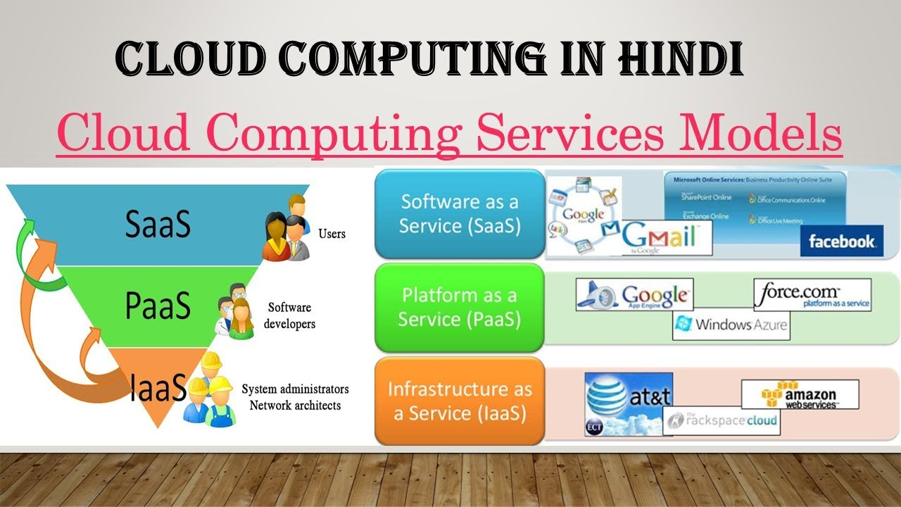

Slide 39
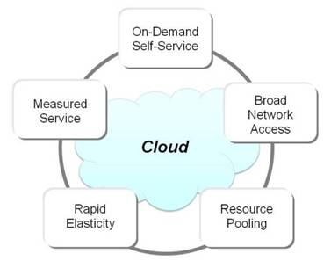
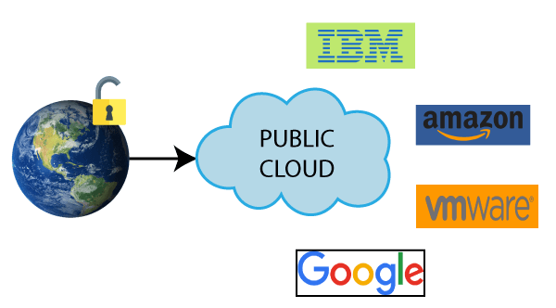
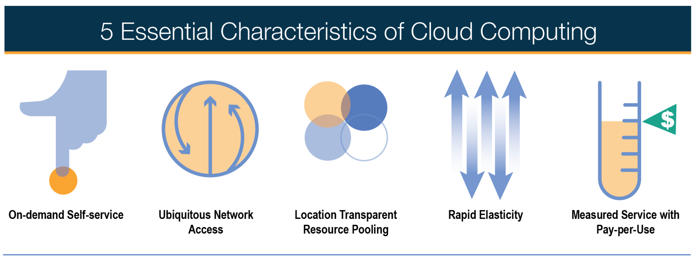
Characteristics of Cloud

Slide 40
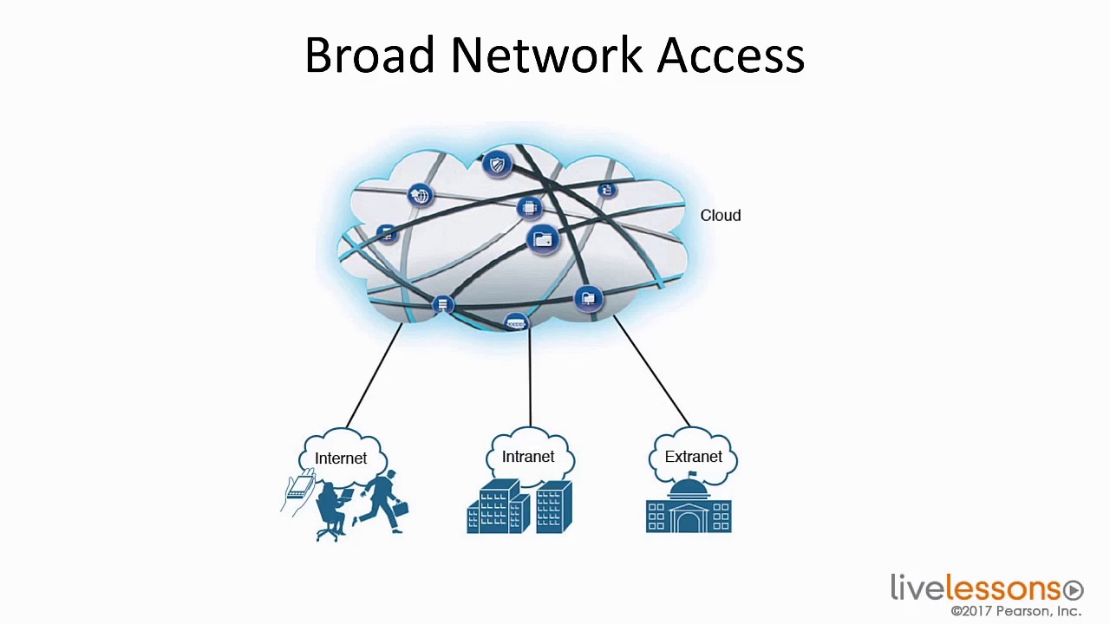
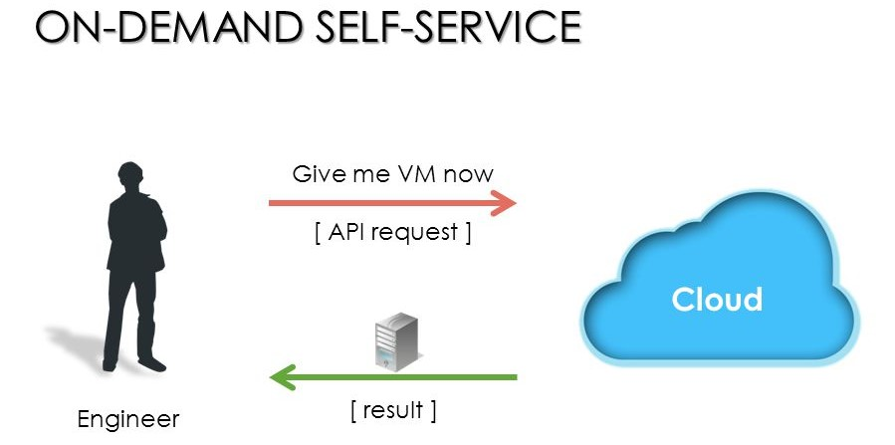
Characteristics of Cloud
A) On demand self services:
computer services such as email, applications, network or server service can be provided without requiring human interaction with each service provider.
Cloud service providers providing on demand self services include Amazon Web Services (AWS), Microsoft, Google, IBM and Salesforce.com.
B) Broad network access:
Cloud Capabilities are available over the network and
accessed through standard mechanisms that promote use by heterogeneous thin or thick client platforms such as mobile phones, laptops and PDAs.

Slide 41
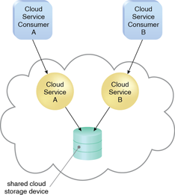
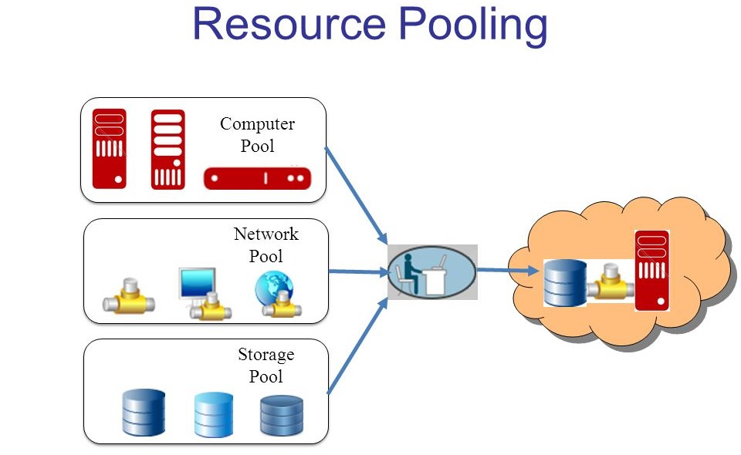
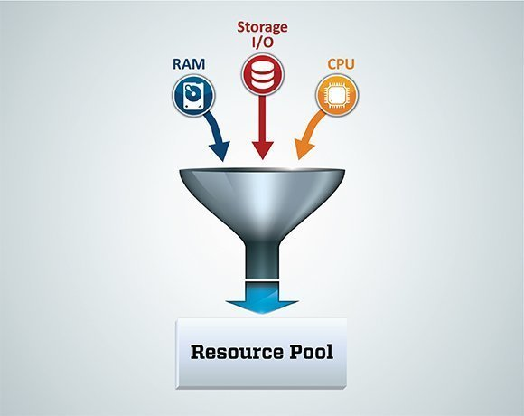
Characteristics of Cloud
C) Resource pooling:
The provider’s computing resources are pooled together to serve multiple consumers using multiple-tenant model, with different physical and virtual resources dynamically assigned and reassigned according to consumer demand.
The resources include storage, processing, memory, network bandwidth, virtual machines and email services as mobile phones, laptops and PDAs.

Slide 42
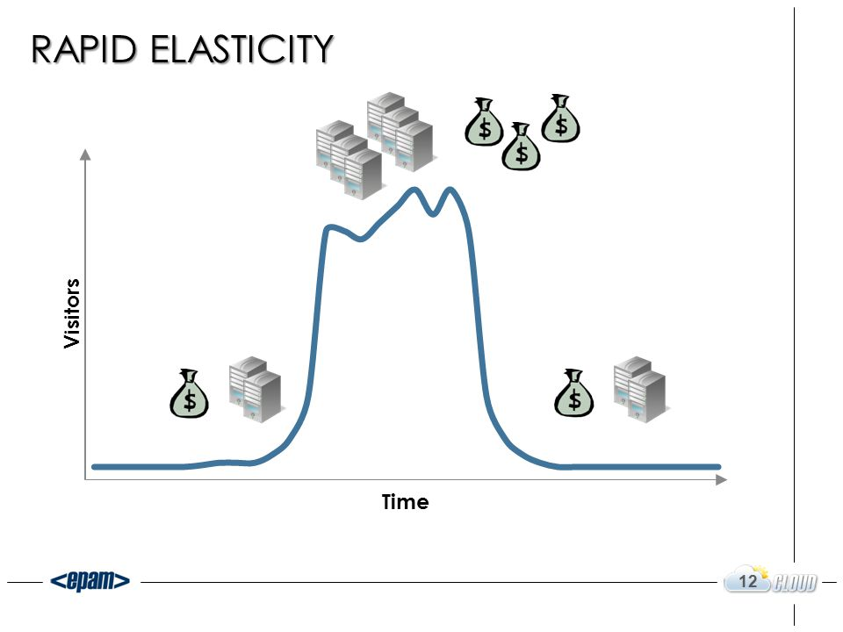
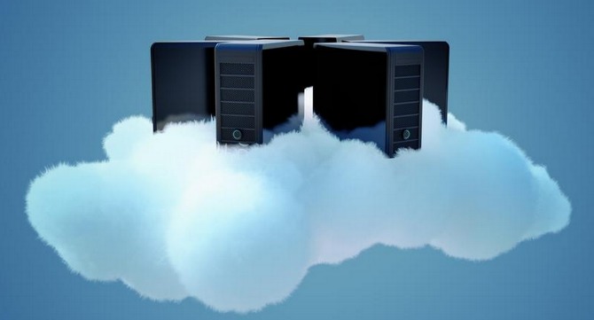
Characteristics of Cloud
D) Rapid elasticity:
Cloud services can be rapidly and elastically provisioned, in some cases automatically to quickly scale out and rapidly released to quickly scale in.
To the consumer, the capabilities available for provisioning often appear to be unlimited and can be purchased in any quantity at any time.
Rapid elasticity allows users to automatically request additional space in the cloud or other types of services. Because of the setup of cloud computing services, provisioning can be seamless for the client or user.

Slide 43
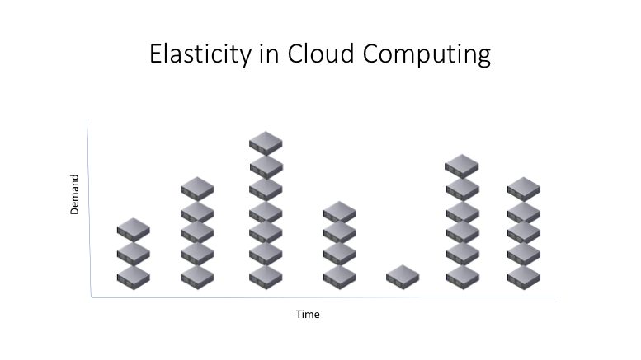
Characteristics of Cloud
Elasticity allows the cloud provider’s customers to achieve cost savings and this is often a core reason for adoption of cloud services
Example - Say that 10 servers are required for a three month project. With cloud services the company can provision them within minutes, pay a small monthly operation + execution fee to run them rather than a large upfront capital investment cost, and decommission them at the end of the three months with no further charge.

Slide 44
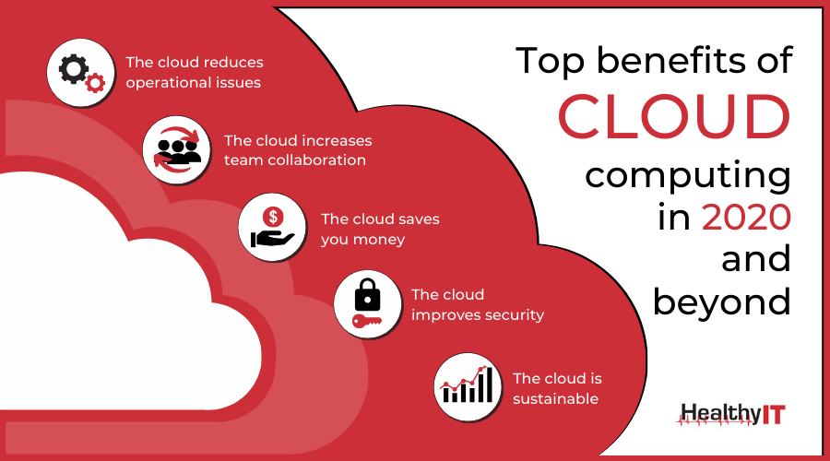
Benefits

Slide 45
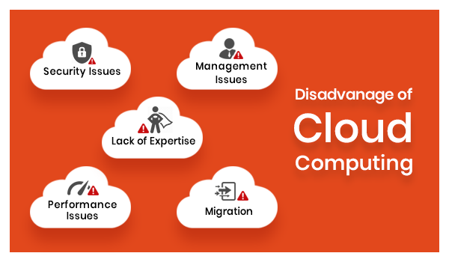

Slide 46
The Edge of the Cloud
Why isn’t cloud computing sufficient for some applications?
Latency – Real-time interaction
Video Streaming – Movies, Video Conferencing
Gaming – Role playing games
Augmented Reality – Pokémon Go
Geographical Distribution – Widely distributed deployments
Massively Multiplayer Online Real-time Games
Route Planning / Traffic
Mobile Deployment – Nodes will be moving
Cell phones
Vehicles
Large number of Nodes
Networks of sensor nodes

Slide 47
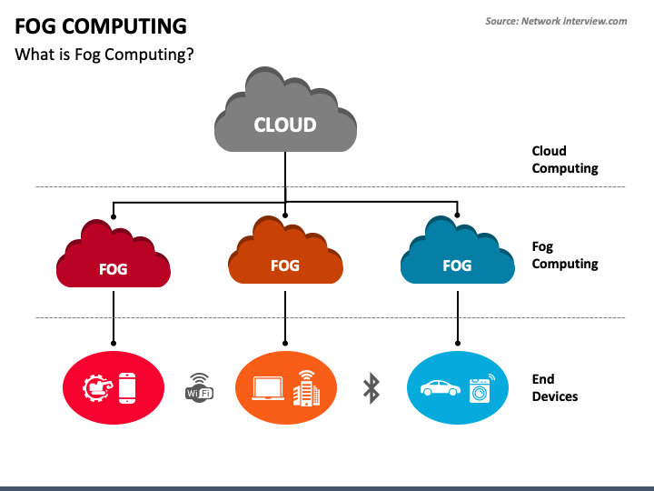
Fog Computing
Fog platform provides low-latency virtualized services and is linked to the Cloud Computing infrastructure.
Edge devices request compute, storage and communication services from the Fog. The Fog provides local, low-latency response to these requests and forwards relevant data for computationally intensive processing.
Fog Computing: Survey of Trends, Architectures, Requirements, and Research Directions

Slide 48
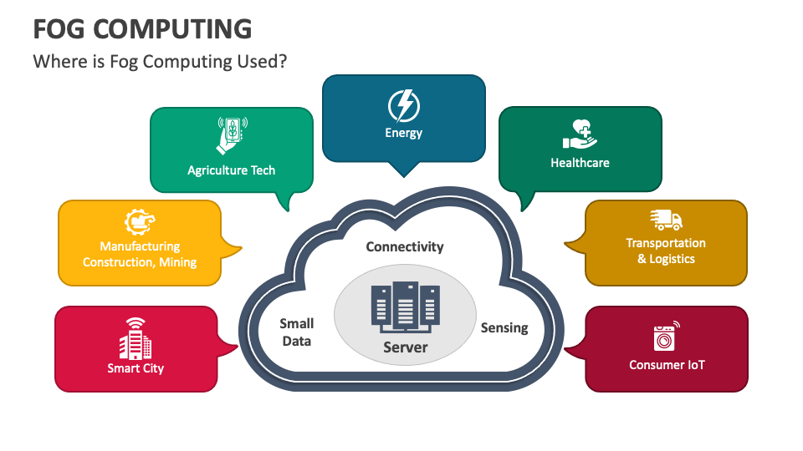

Slide 49
Fog Computing Characteristics:
Low Latency – Video Delivery, Navigation Information
Location Awareness – Traffic Lights, Navigation, Sensor Networks
Wide-spread Geographical Distribution
Mobility – Fitness Trackers, Phones and Vehicles

Slide 50
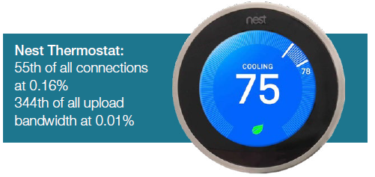
Fog Computing Characteristics:
Predominance of Wireless Access
Strong presence of Streaming and Real-time Applications
Heterogeneity
www.sandvine.com/hubfs/downloads/phenomena/2018-phenomena-report.pdf

Slide 51
Architectural Drivers
Low Latency / Real Time Response – Device will want near real-time response for content delivery and actionable information
Dynamic Number of Nodes -- Number of devices within the Fog is dynamic. System must be able to handle large number of devices joining and leaving the Fog
Highly Mobile Nodes – Nodes will be entering and exiting the Fog and the Fog must adapt and continue to perform
Diverse Set of Failure Modes – Wide range of devices with varying levels of sophistication mean there will be many failure modes that need to be seamlessly handled
Security – Access control
Notes:
Issues to think about – Security & data synchronization

Slide 52
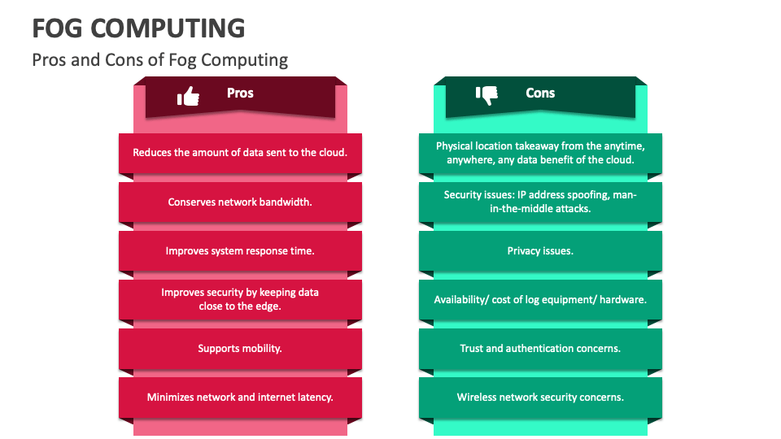

Slide 53
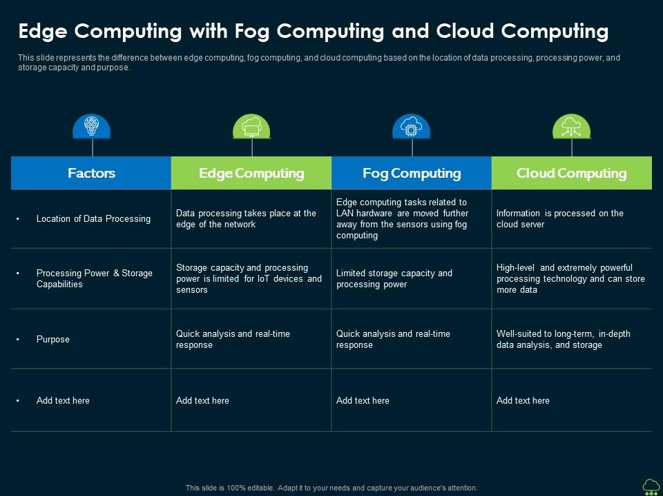
https://arxiv.org/pdf/1701.01090.pdf

Slide 54
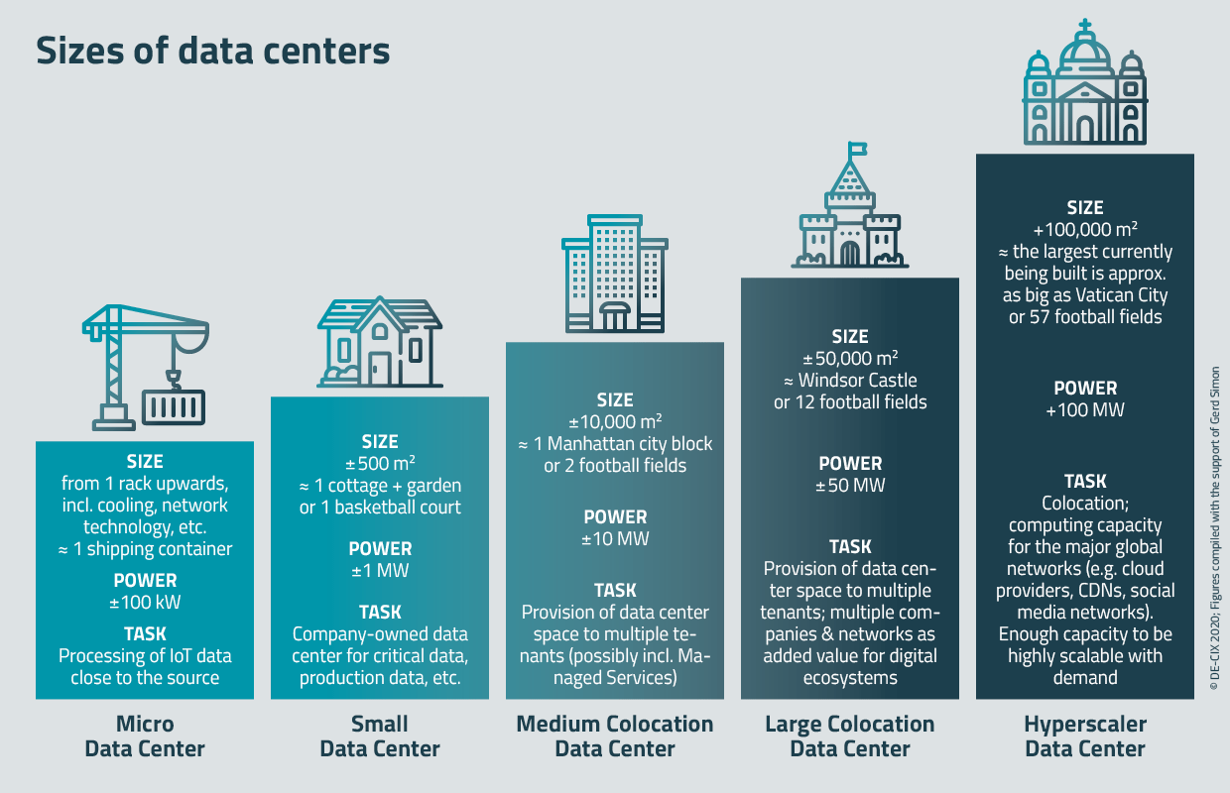
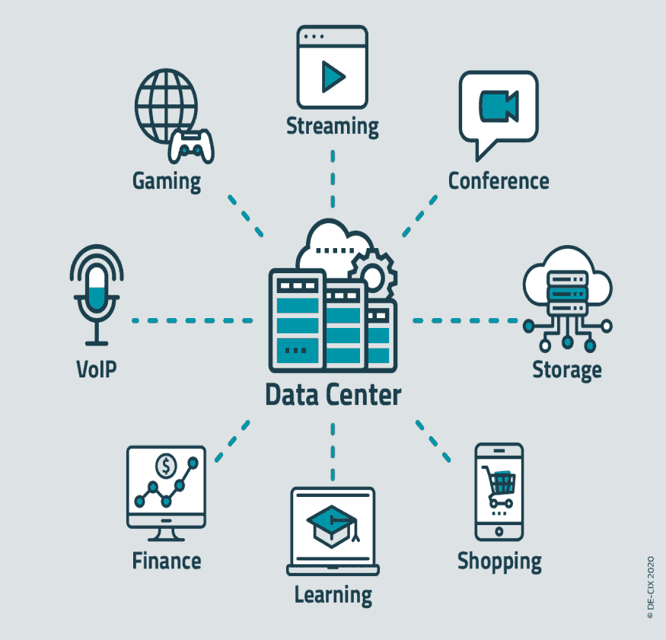
The Role of the Data Center
Data centers are an integral part of the enterprise, designed to support business applications and provide services such as:
Data storage, management, backup and recovery
Productivity applications, such as email
High-volume e-commerce transactions
Powering online gaming communities
Big data, machine learning and artificial intelligence

Slide 55


Slide 56


